Slide 1
15+
Meetings
Team Work
70+
Hours
Functions
Project HANGMAN
B
A
11762 KASHIF (Leader)
Skills We Learn
13016 SHAHZAIB KHAN
75% Success
13021 SUMAIR NOAMAN
80%
Skills Learnt
Array
If else & Loop

Slide 2
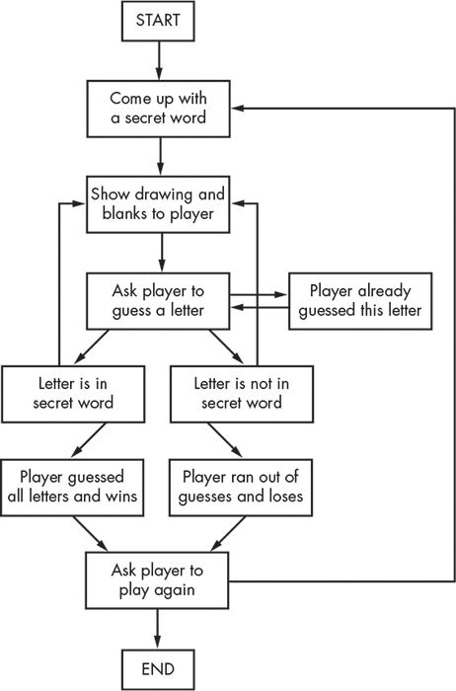

Slide 3
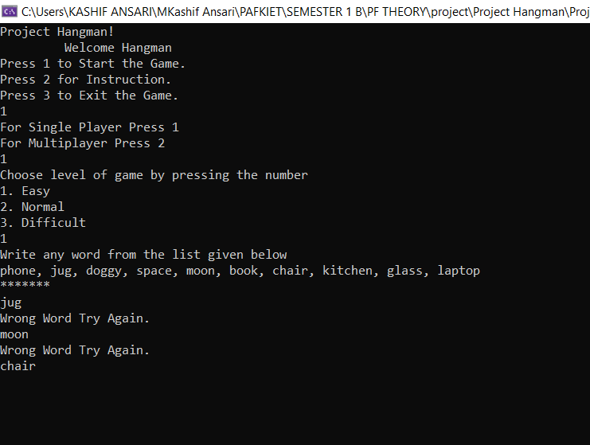
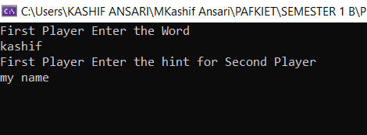
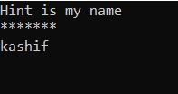
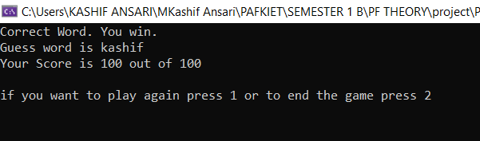
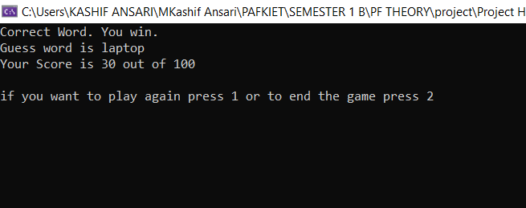
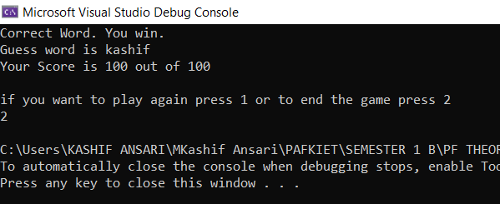

Slide 4
Thanks for Listening with great patience, If you have any Question You may ask
Class Id : 105911 Subject : Programming Fundamental

